Slide 1
Vision and Cognitive Systems
Detection, Rectification and Localization of Paintings and People in a Museum
Werther Berselli
Luca Casarotti
Laura Valentini
Notes:
Good morning everyone, I’m Werther Berselli,................... Our presentation talks about methods and techniques that we used for the Detection, Rectification and Localization of Paintings and People in a Museum.

Slide 2
Paintings and People Detection
Approach: Train a model
Analyze Results
Comparing the maP results using only paintings or paintings and people.
03
Data gathering
Labelled data for the training process.
01
02
Training
Training process using Yolo v4.
Notes:
The task including the painting and people detection has been accomplished by training a model. We first gathered data and then used Yolov4 to implement and train the model. We have compared two different approaches: training a model only on paintings versus training a model on paintings and people togheter.

Slide 3

Paintings and People Detection - Data
Data for the Training
Video bbox
40,000 painting + 3,200 people annotated images
9,000 images training dataset
Notes:
Firstly, in order to obtain enough data for the training process, we used a tool called video_bbox to label videos obtaining around 40’000 annotated images containing paintings and over 3’200 containing people. We have then reduced the resulting dataset up to 9’000 images by skipping 4 continuous frames every 5 to avoid the risk of overfitting.

Slide 4
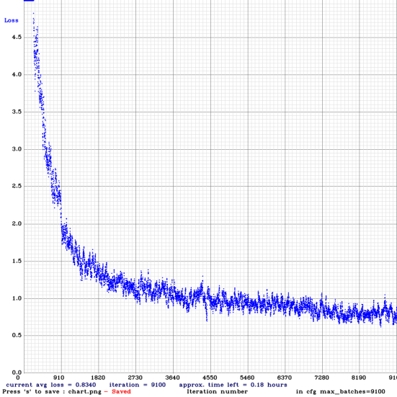
Paintings and People Detection - Training
Training and Results
Yolo V4
Only paintings → maP of 97%
Both paintings and people → maP of 87.09 %
Combined weights for both people and paintings
Notes:
We used YOLO v4 to train the network. Our first attempt was to a network only to recognize paintings, obtaining an accuracy of around 97%. Afterwards, it was decided to use a single model both for people and paintings.
We trained the final network on a GTX 1080 single GPU: the overall process took around 15 hours. The training resulted in 9100 iterations with a maP of 87.09%. At the end of the training, this loss graph was obtained.

Slide 5
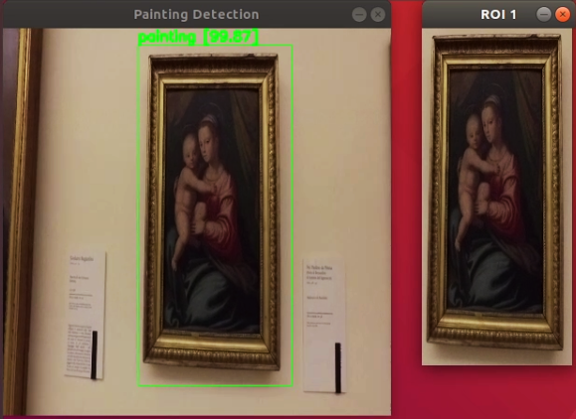
Painting detection example
Notes:
Here’s an example of what the painting detection looks like from the preview shown to the user...

Slide 6
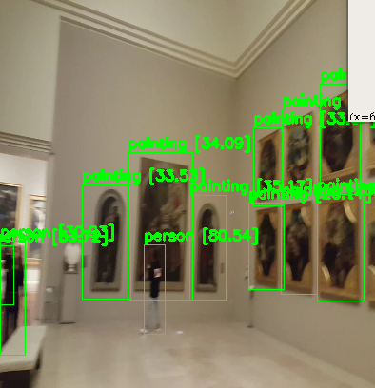
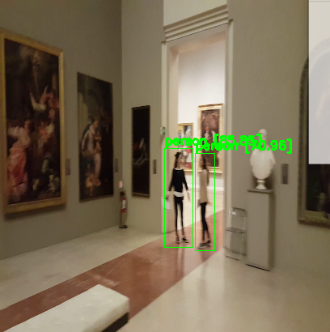
People detection example
Notes:
… and an example for the people detection.

Slide 7
Painting Rectification
Input: ROI image
Approach: find points to rectify the perspective and remove the frame of the painting if present
2 methods to find the right points for the Perspective Transform
Search for polygons
Segmentation
Notes:
The rectification task works with an image containing a detected painting and the data related to its bounding box.
The input of the rectification is the ROI image. We implemented two different approaches to find the right points for the rectification of the perspective.

Slide 8
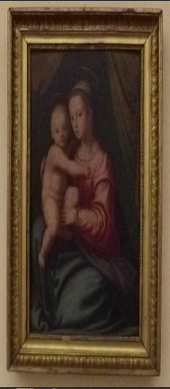
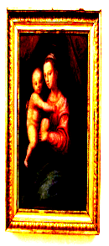
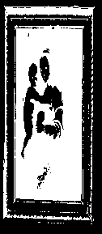
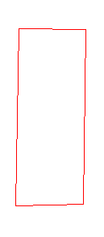
Approach 1: Polygon search
Original Image
alpha + beta
Binary_Inv Threshold
ApproxPolyDp + Contours

Slide 9
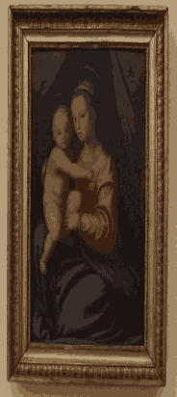
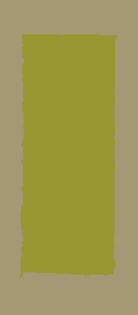
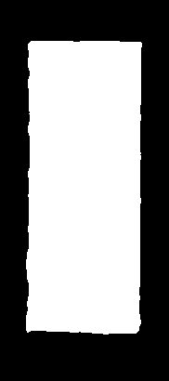
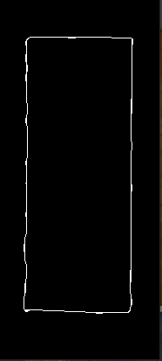
Approach 2: Segmentation
Original Image
K-means
SLIC
Otsu Threshold
Canny + Closing

Slide 10
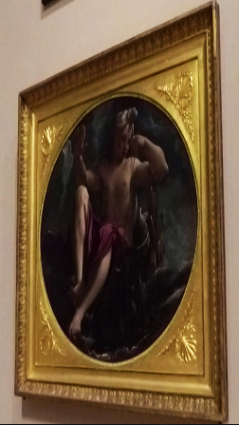
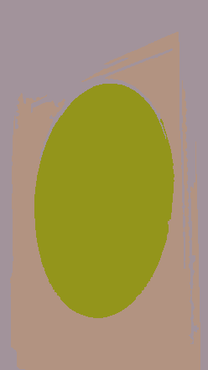
Approach 2: Segmentation
Works best also with other shapes!

Slide 11
Comparison approaches
More precise
Works best with rectangular paintings
Uses many sets of parameters
Find Polygons
2 approaches
Less precise
Works with every shape
Same parameters for every image
Segment the image

Slide 12
Rectification: final
goodFeaturesToTrack() → 4 points = corners
Order: [top-left, top-right, bottom-right, bottom-left] → W, H
getPerspectiveTransform() and warpPerspective()
1
2
4
3
Notes:
Once one of the approaches returns the mask, a method called findCorners() is applied. Thanks to the OpenCV function goodFeaturesToTrack(), it detects four points, corresponding to the corners, and returns them. These four points are, first of all, ordered such that the entries in the list follow this syntax [top-left, top-right, bottom-right, bottom-left].
The four ordered points are then used to compute the width and height of the new image with which it is possible to construct the set of destination points to obtain a “birds eye view”. Now, it is possible to compute the perspective transform matrix and apply it to warp the image thanks, respectively, to the OpenCV functions getPerspectiveTransform and warpPerspective.

Slide 13
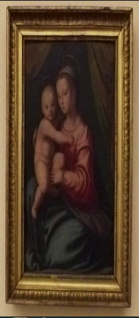
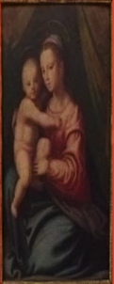
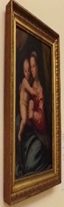
Rectified Image
Original Images
Rectified Image

Slide 14
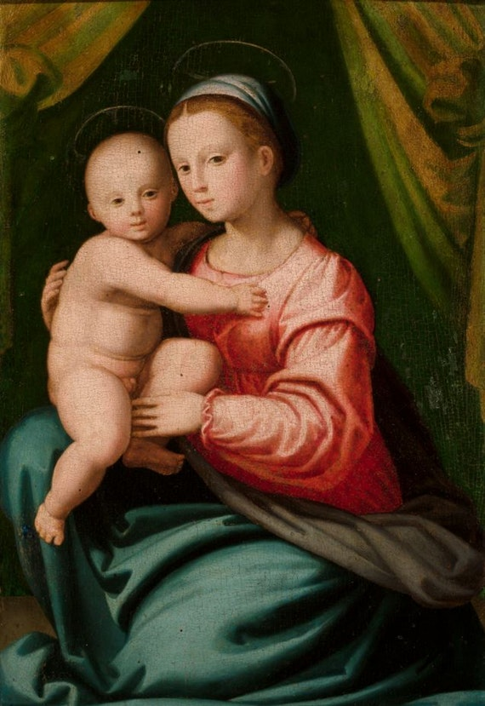
Painting Retrieval
Algorithm: DHash (Difference-Hash)
Accurate and fast
DHash:
Image reduced to 9x8 grayscale
Compute difference hash
Method
Set up phase: DB hash values stored
ROI: compute hash and compared
min_difference < threshold => match
Notes:
The retrieval task works with the cut and rectified painting and outputs, in case of a match with the given database, the data related to the most probable result.
After some experiments we then decided to implement the DHash algorithm, looking for a fast and accurate approach for this task.
The algorithm is pretty simple:
- The ROI input image is reduced first in color scale and then in size producing a 9x8 (“by”) grayscale image.
- The algorithm to produce a difference hash is pretty simple: it produces a 64-bit “row hash” (1 bit means increasing in x direction, 0 means decreasing) and a 64-bit “column hash” in the same way for the y direction. The two values are then combined to produce the final 128-bit final hash value. Basically, the difference between pixels and their nearest neighbors are computed and, with the results, the algorithm computes an hash.
- In the setup phase of the task, the hash values related to the images contained in the database are calculated.
- For each ROI processed, the corresponding hash is computed and compared to all the database stored hash values, using a distance measure. If the minimum value is below a predefined threshold, the corresponding painting data are retrieved and printed on console.
This algorithm turned out to be really fast and efficient on every test performed, with a good detection accuracy.
Not great with similar images but very good for finding exact duplicates and near duplicates, for example, the same image with slightly altered lighting, a few pixels of cropping, or very light photoshopping.

Slide 15
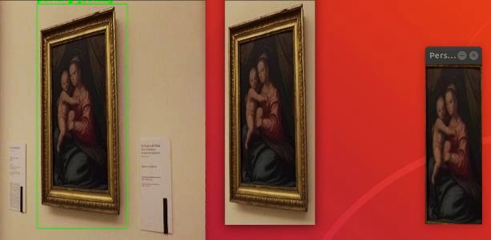
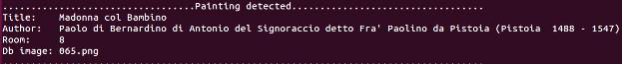
Painting Retrieval
Notes:
Here’s an example of the output!

Slide 16
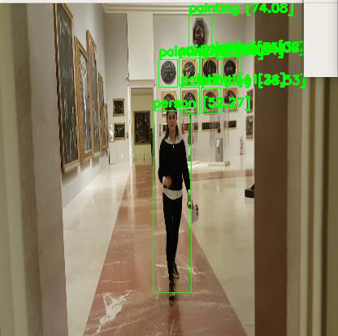
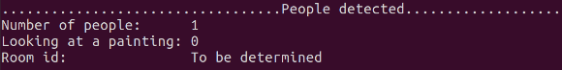
People Localization and People facing a painting
People Localization
room_id from painting retrieval
Every person detected assigned to that room
People facing a painting
Two networks
People detected - Faces detected
Notes:
For the people localization task we used the data retrieved from the painting retrieval. After detecting all the paintings inside a frame, if a painting is also found inside the database, the room_id is saved and every person detected in the same frame is assigned to that room. The information is the printed on the console.
The number of people facing a painting in a frame is acquired using the information retrieved by placing side by side a pre-trained face detection network with the already trained people detection network. To be more specific, for each frame, the algorithm computes the number of people and the number of faces in the scene and subtracts them. People whose face is hidden are considered likely to be facing a painting. The resulting number is printed on console.

Slide 17
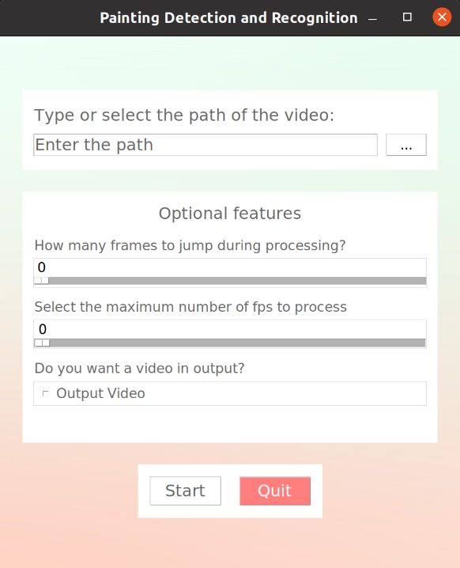
Additional features
Easy and clear GUI for the user
Skip frames to fasten the processing
Select the fps limitation
Save locally the preview video
PAUSE option during processing
Notes:
We implemented a graphic user interface and some additional features to make the user experience more flexible.
· First of all, the Graphic User Interface makes the application as simple to use and configure as possible. Through the GUI it’s possible to customize some parameters related to the computation. These options do not include rectification parameters, which might be tricky to understand from the point of view of the end user.
· The options include:
o A “skip” factor which allows the user to reduce the total video computation time skipping n frames after each processed frame. It is highly useful with long videos.
o If the computation is too chaotic, there is an option allowing to set an FPS limiter to slow down the process.
o And it is also possible to produce an output video saved locally showing the preview of the detection process.
· Another feature is the possibility to pause the video computation at any time pressing the <space> button to allow the user to stop and analyze the progress made so far. Pressing <space> again will resume the computation. It does require sudo privileges.

Slide 18

Results
Qualitative accuracy check
Tested on 3 different systems, all CUDA-enabled:
I7 9850H, GTX 1650
Ryzen 3700X, GTX 970
I7 2600K, GTX 1080
2 scenarios:
Simple video → 2 paintings
Complex video → 30 paintings, 4 people
Notes:
Here, some performance measurements.
Talking about accuracy, we decided to go for just some qualitative checks, given the incomplete dataset we had to work with. The program resulted working smoothly with every video tested. We focused our tests mainly on time measurements.
We tested the application on three different systems, all CUDA-enabled:
1. Laptop with I7 9850H, GTX 1650
2. Ryzen 3700X, GTX 970
3. I7 2600K, GTX 1080
And taking into account 2 different scenarios:
· A much simpler video containing only two paintings;
· and a more complex video with 30 paintings and 4 people detected.
Tests have been performed both separately on each task and all together to better understand the weight of each task in the total process.

Slide 19
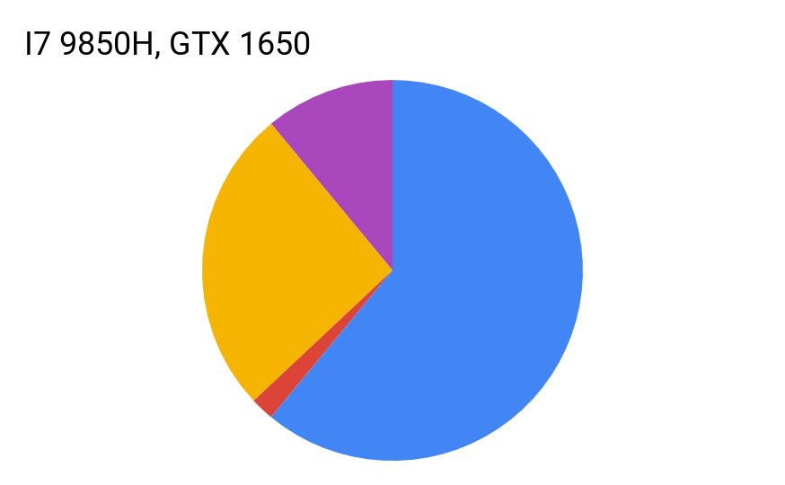
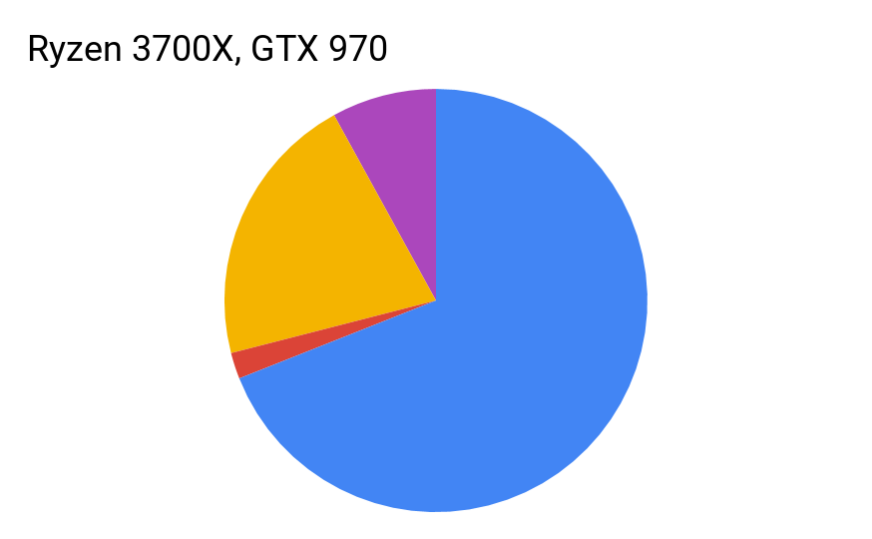
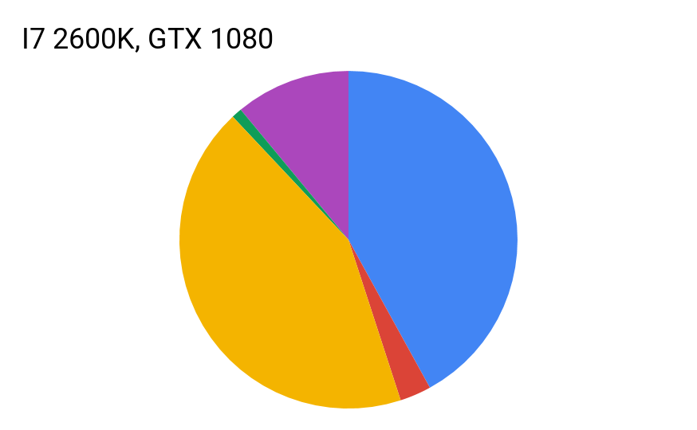
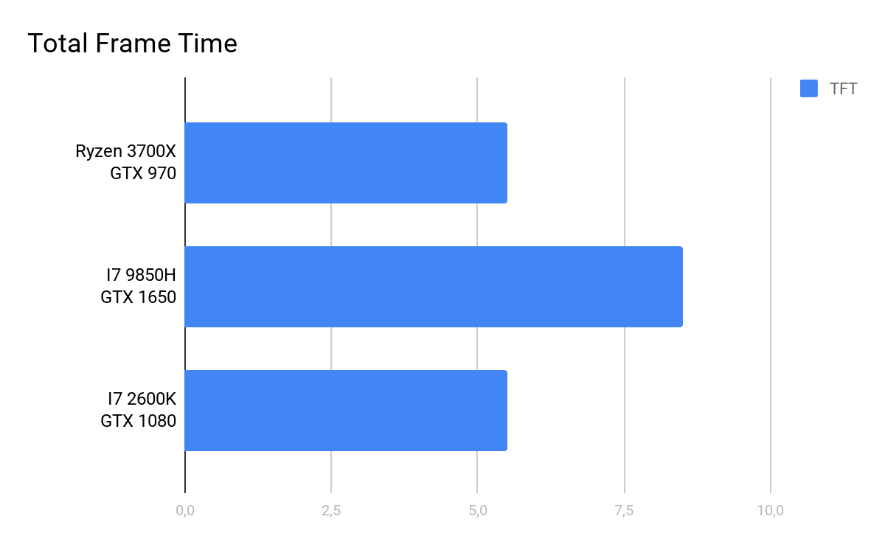
Results - simple video
11%
8%
11%
0%
0%
1%
21%
26%
42%
2%
43%
61%
69%
2%
3%
Detection
Retrieval
Rectification
Avg: 17 FPS
Output
Others
(ms)
Notes:
In the following pie charts we can see the time performance of every system related to the single task taken into consideration. The Others field is related to other time consuming tasks such as overheads and cv.imshow() calls.
The painting detection is the only task which can actually benefit from CUDA acceleration. In that case, the GTX 1080 showed the best performances. For every other task, the fastest Ryzen 3700X performed better than the other two systems.
In the simple case, there is a maximum of only two paintings per frame which prevents the Others field from affecting excessively the total time (~10%). The average FPS for this case was calculated around 17 FPS (~ 0.06 SPF).

Slide 20
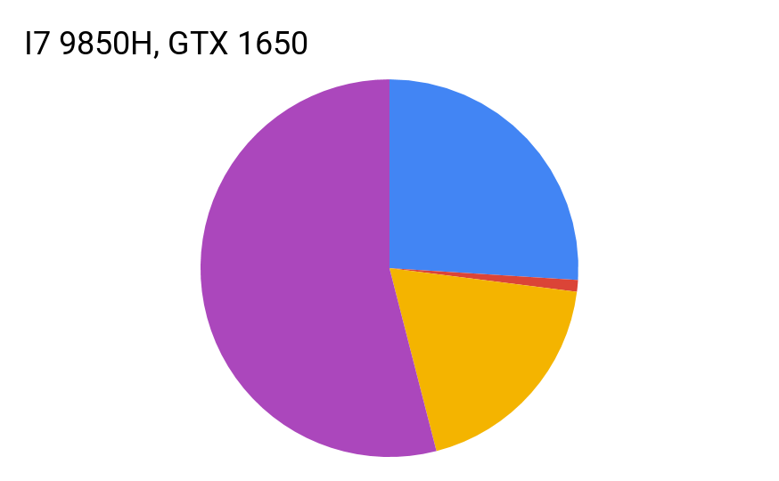
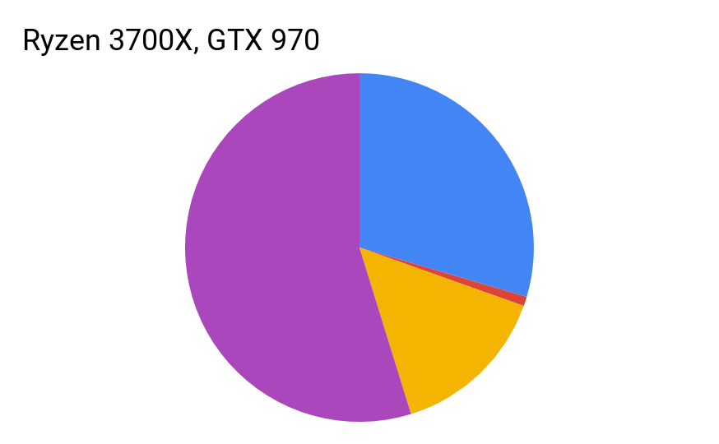
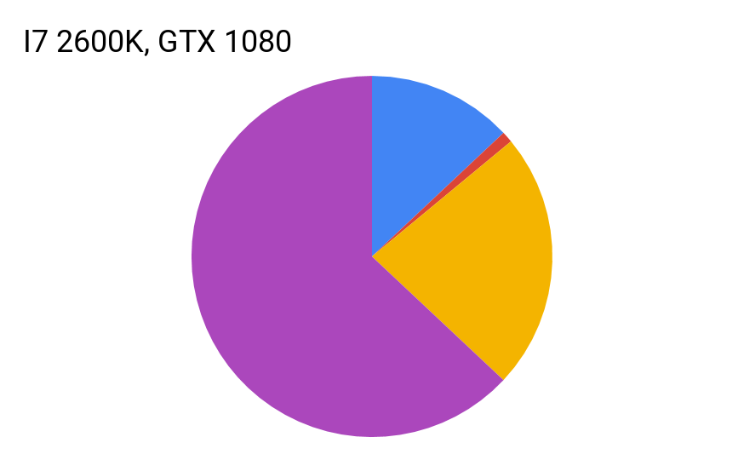
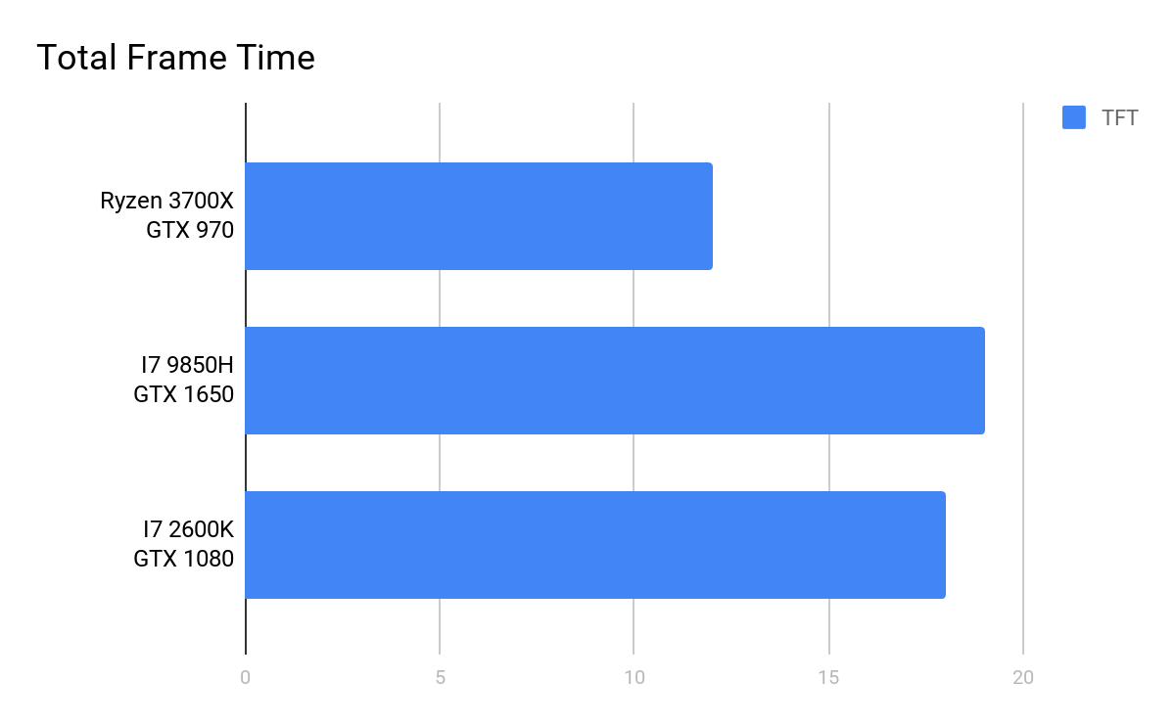
Results - complex video
26%
13%
34%
1%
48%
54%
23%
1%
63%
1%
19%
17%
0%
0%
0%
Detection
Retrieval
Rectification
Avg: 7 FPS
Output
Others
(ms)
Notes:
In the complex case every task turned out to be way heavier, as expected. In this case, the Others field affected significantly the Total frame time. This consequence is due to the large number of cv.imshow() calls, several for each frame but necessary to show an explanatory preview to the user.
The average FPS for this case was calculated around 7 FPS (~ 0.15 SPF).

Slide 21
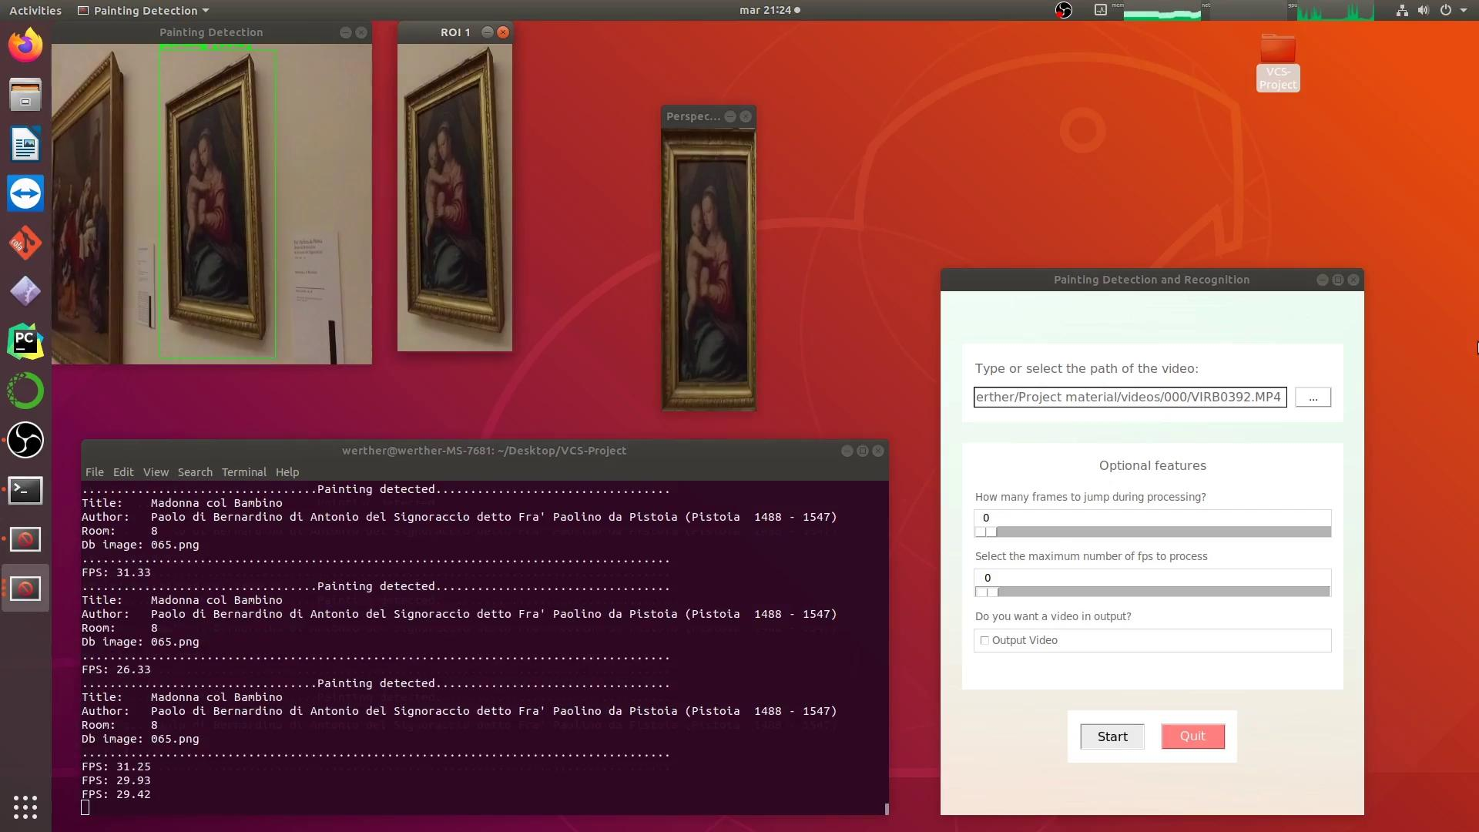
Notes:
Here’s a quick demonstration!

Slide 22
Thanks for your attention

